Slide 1
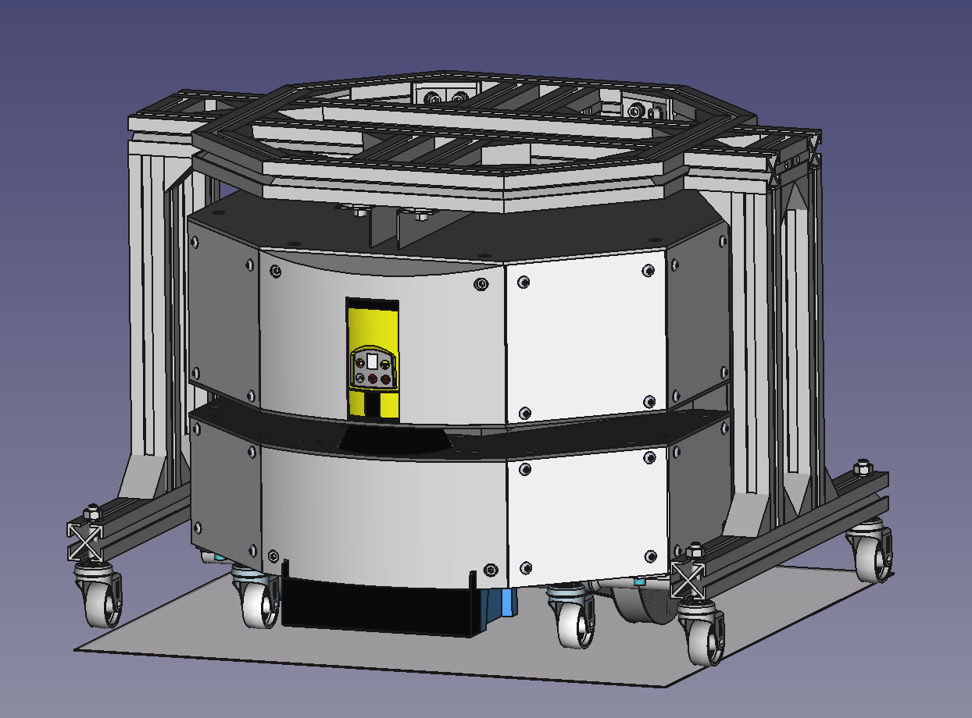
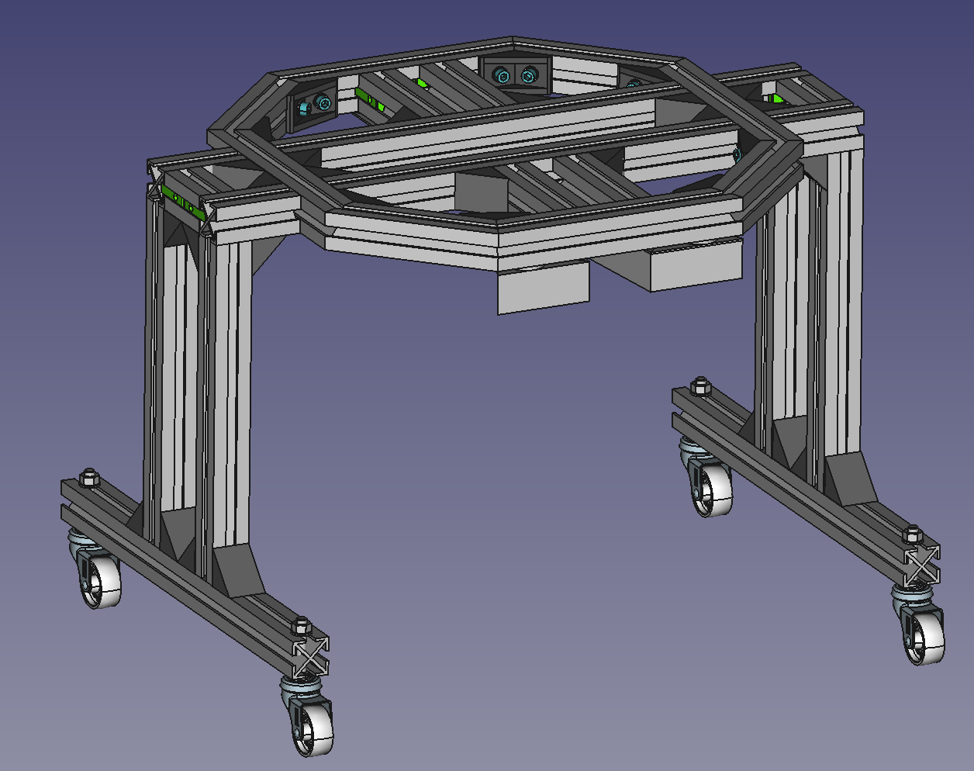
Trolley
Parts manufacturing

Slide 2
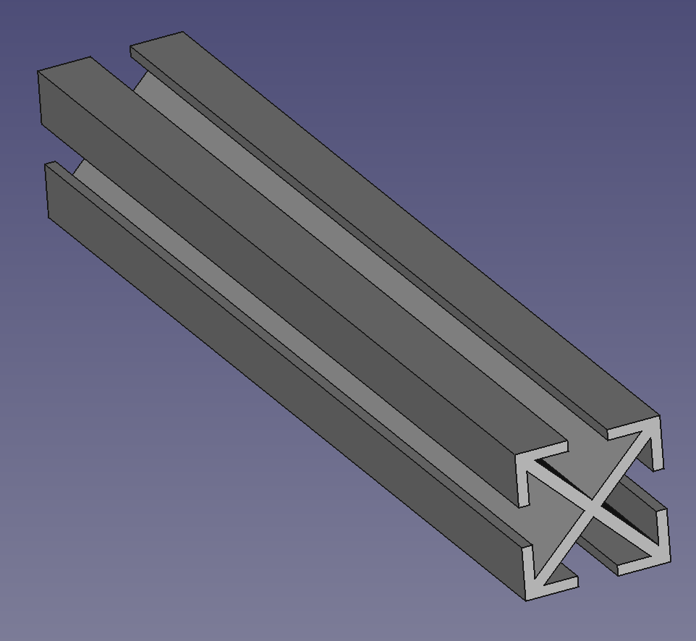
NOTE P176: In the each unit make two 8,2mm hole at 20mm from edge for caster wheels
P0156 | 30x30_109 mm profile flat cut | Units: 4, Assembly: Base
P0171 | 30x30_339mm profile flat cut | Units: 2, Assembly: Base
P0176 | 31x30_400mm profile flat cut | Units: 1+1, Assembly: Leg-Right, Leg-Left
P0177 | 32x30_271mm profile flat cut | Units: 2+2, Assembly: Leg-Right, Leg-Left
P0175 | 30x30_60mm profile flat cut | Units: 1+1, Assembly: LegSupport-Right / Left
P0178 | 30x30_70mm profile flat cut | Units: 2+2, Assembly: LegSupport-Right / Left
Source model for all: “30x30 profile” / 30x30 profiles.FCStd

Slide 3
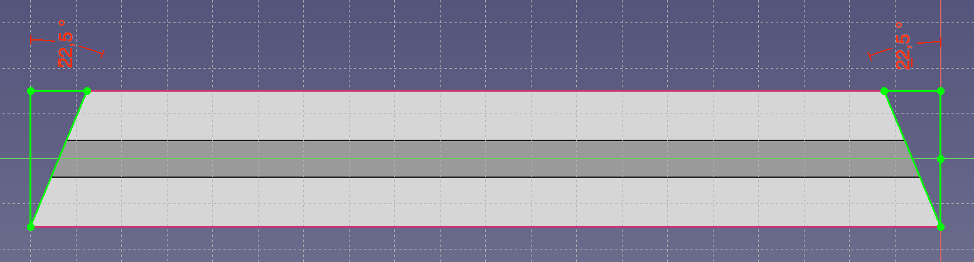
Length long side: 204mm
Cut angle: 22,5deg both sides
Units: 4
Assembly: Base
P0160 | 30x30 204mm profile 22,5deg cut
Length long side: 138mm
Cut angle: 22,5deg both sides
Units: 4
Assembly: Base
P0165 | 30x30 138mm profile 22,5deg cut
Source model for all: “30x30 profile” / 30x30 profiles.FCStd

Slide 4
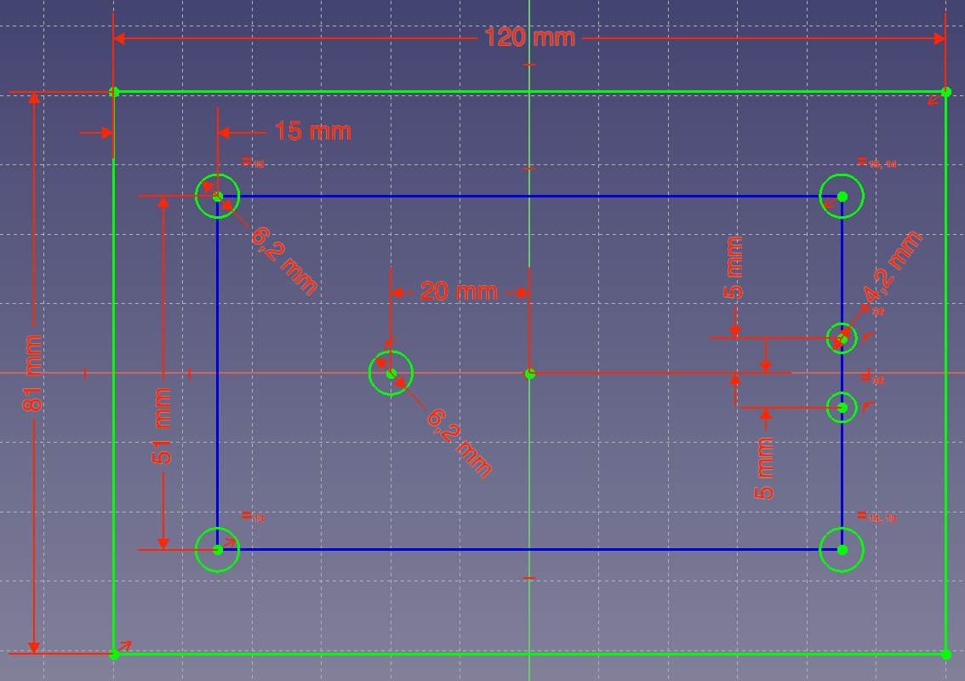
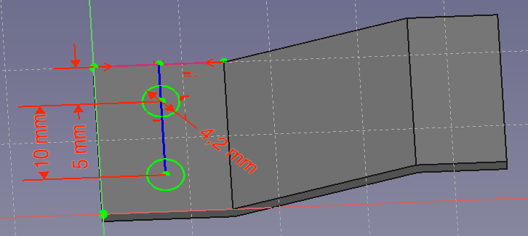
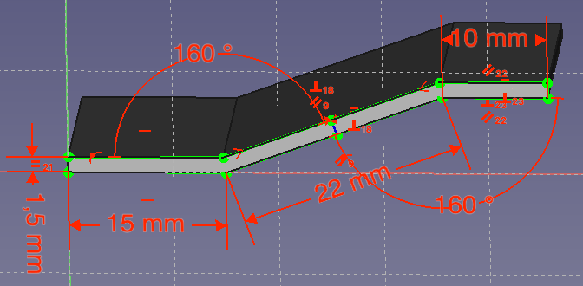
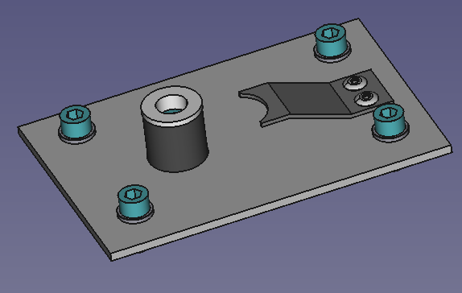
P0381 | Anchorage base sheet
P0391 | Steel trigger
20mm width, 47mm length
Source model: “Anchorage Set” / Trolley v1.3.FCStd

Slide 5
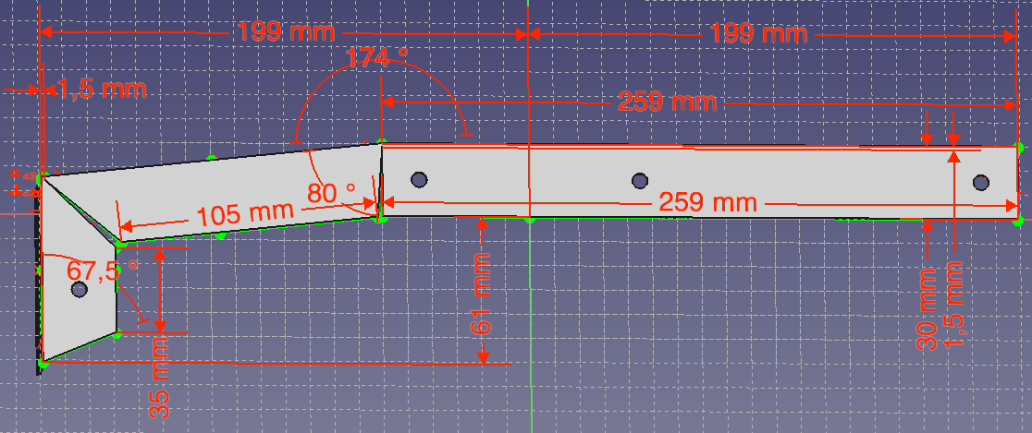
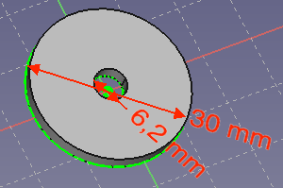
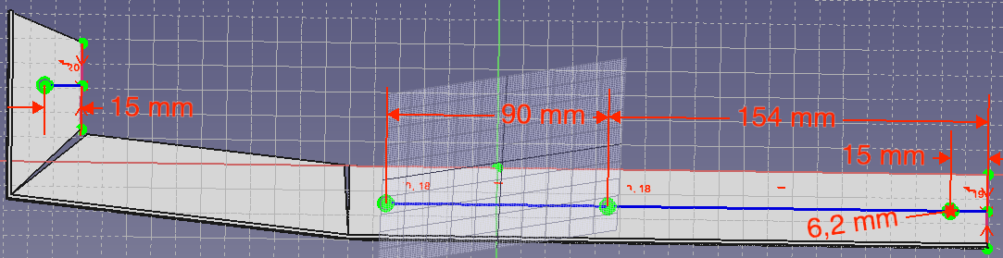
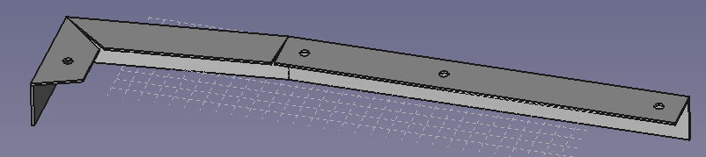
P0206 | Aluminum Profile L shape 30x30x1,5 with rail shape R
P0207 | Aluminum Profile L shape 30x30x1,5 with rail shape L
P0382 | 3mm washer
30x30x1,5 profile, 476mm long
140mm
77mm
3mm width
Source model: “Rail Set” / Trolley v1.3.FCStd

Slide 6
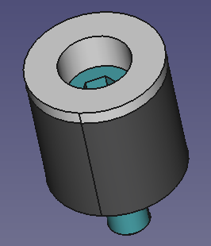
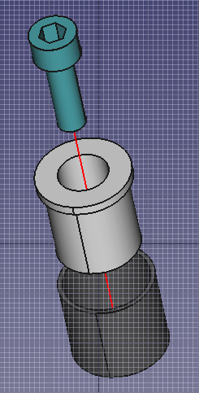
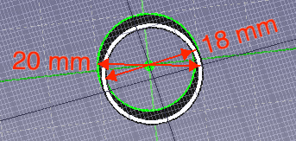
P0322 | Anchorage front limit
18mm length
Source model: “Anchorage Set” / Trolley v1.3.FCStd

Slide 7
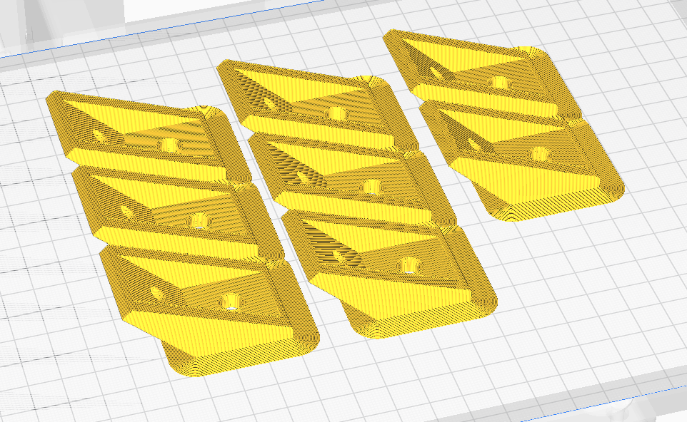
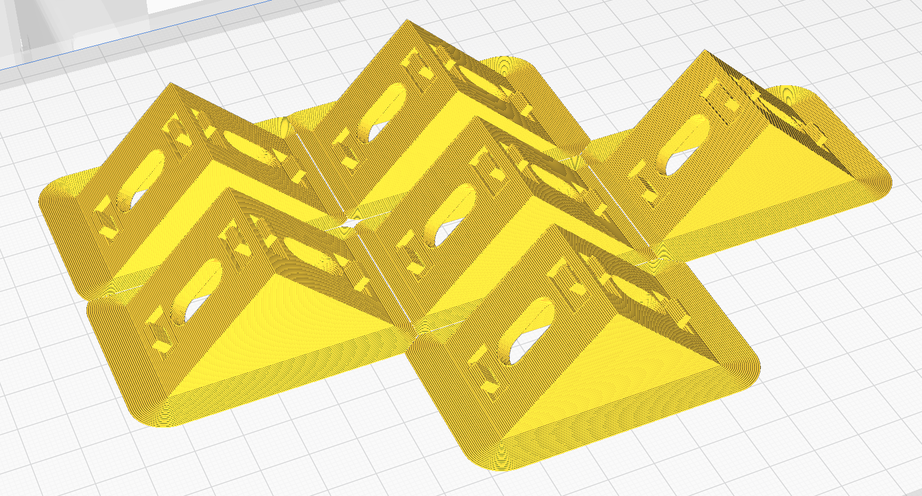
P0011 | 135 degree bracket
Units: 4 + 4, Printer file: 135deg bracket type 002 x8.gcode (x8 parts)
Material: PLA, Color: Gray, Weight: 63g, Printing time: 4h 18m
Assembly: Chassis Top, Chassis Bottom
Source Model: “135 degree bracket type 002” / 135 degree bracket.FCStd
P0021 | 90 degree bracket
Units: 4 + 2, Printer file: ﻿30x30 corner bracket type 002 x6.gcode (x6 parts)
Material: PLA, Color: Gray, Weight: 48g, Printing time: 3h 26m
Assembly: Chassis Middle, Set limit motors Top
Source Model: “﻿30x30 corner bracket type 002” / AGV-Parts v4.FCStd

